Slide 1
An Analysis on Cryptocurrencies
Kevin Z & Marc S

Slide 2
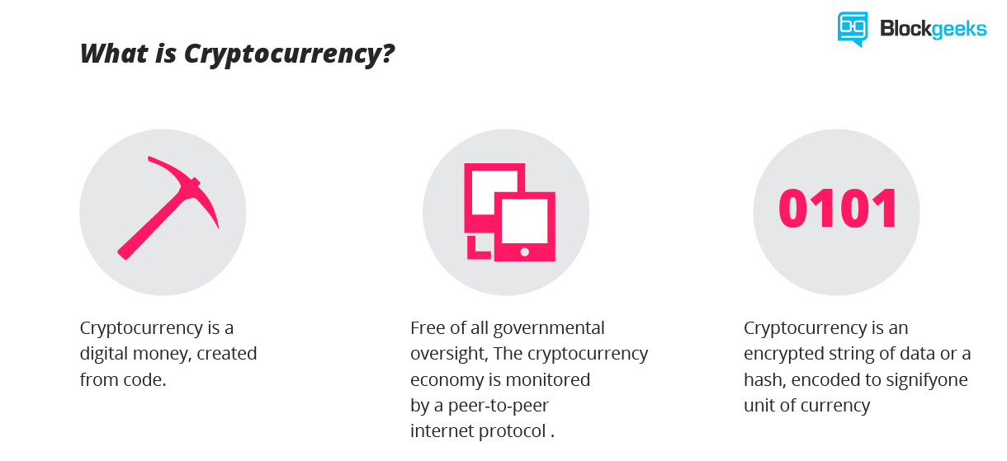
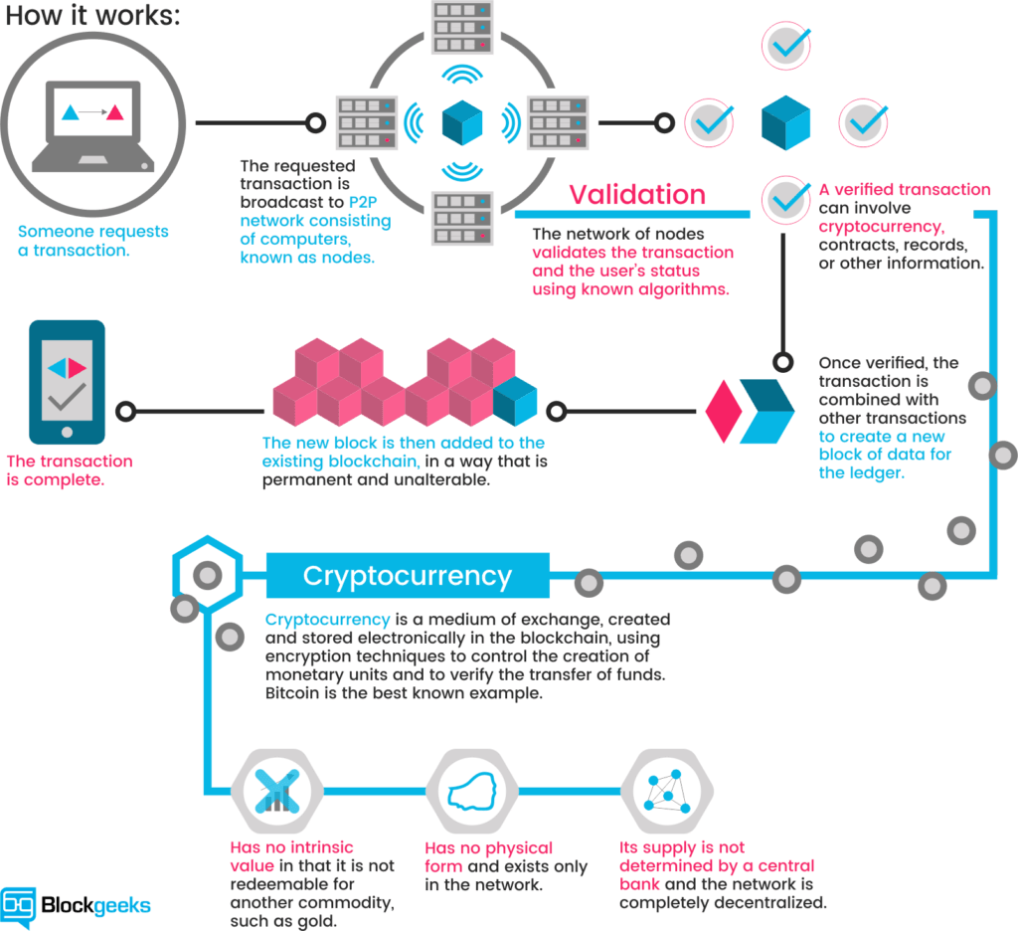
What are cryptocurrencies?
A discussion about cyptocurrencies would be incomplete without an introduction to blockchain technology.

Slide 3

Why are cryptocurrencies important?

Slide 4


Slide 6
Coins Studied in our analysis:
Top 3 | Top Quartile | Median | Bottom Quartile | Bottom 3
Bitcoin: BTC | Dogecoin: DOGE | Verge: XVG | Loopring: LRC | Elastos: ELA
Ethereum: ETH | Vechain: VET | Aeternity: AE | Aurora: AOA | Kucoin: KSC
Ripple: XRP | True USD: TUSD | Stratis: STRAT | Quant: QNT | Wanchain: WAN
From the 100 Top Cryptocurrencies by Market Capitalization
Source: Coinmarketcap.com

